Slide 1
LECTURE 3 A
INDICATING ANALOG INSTRUMENTS
Presented By: Dr. Daniel Opoku
[Major Reference Book: Electrical and Electronics Measurements and Instrumentation; By Prithwiraj Purkait, Budhaditya Biswas, and Chiranjib Koley.]

Slide 2
Analog Instruments
An analog device is one in which the output or display is a continuous function of time and bears a constant relation to its input.
Analog instruments may be classified into two ways:
Absolute instruments: Absolute instruments give the value of the electrical quantity to be measured in terms of the constants of the instruments and to its deflection, no comparison with another instrument being required.
E.g. The tangent galvanometer
No calibration of the instrument is thus necessary.
Secondary instruments: The value of the quantity to be measured can be determined from the deflection of the instruments by comparison with either an absolute instrument or one which has already been calibrated.
Deflection is meaningless if not calibrated.

Slide 3
Classification of Analog Instruments
Classified based upon the quantity they measure (ammeter, voltmeter)
Classified according to the current that can be measured by them.(DC,AC)
Classified according to the effects used for working.
Classified as Indicating, Recording, And Integrating.
Classified on the basis of method used for comparing the unknown quantity. (Direct / Comparison measurement )

Slide 4
Principle of operation
Magnetic Effect: Majority of analog instruments including moving coil, moving iron and electrodynamic.
Thermal Effect: The effect of the heat produced by a current in a conductor.
Used in thermocouple and hotwire instruments.
Electrostatic Effect: electrostatic voltmeters.
Induction Effect: induction wattmeters and induction energy meters.
Hall Effect: Used in brushless motors to detect the position of the permanent magnet, proximity sensors.

Slide 5
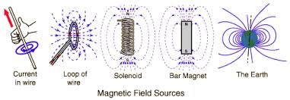
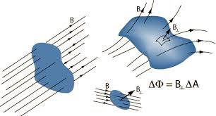
Magnetic Effect

Slide 6
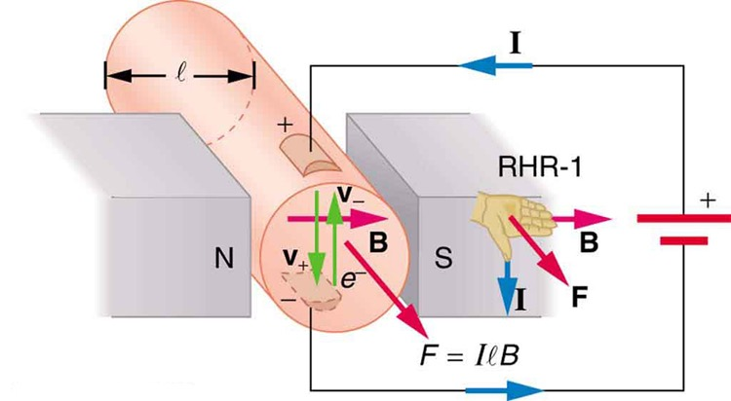
Force between Current carrying Magnet

Slide 7
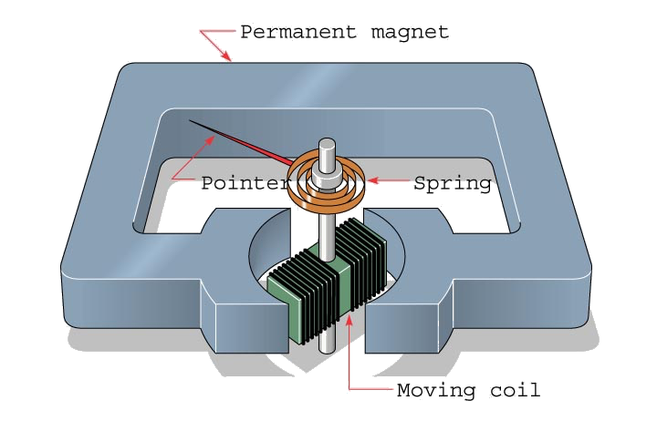

Slide 8
ESSENTIALS OF INDICATING ANALOG INSTRUMENTS
Indicating analog instruments are those which indicate the value of quantity that is being measured at the time at which it is measured. Such instruments consist essentially of a pointer which moves over a calibrated scale & which is attached to a moving system pivoted in bearing. The moving system is subjected to the following three torques:
1. A deflecting ( or operating) torque;
2. A controlling ( or restoring) torque;
3. A damping torque.

Slide 9
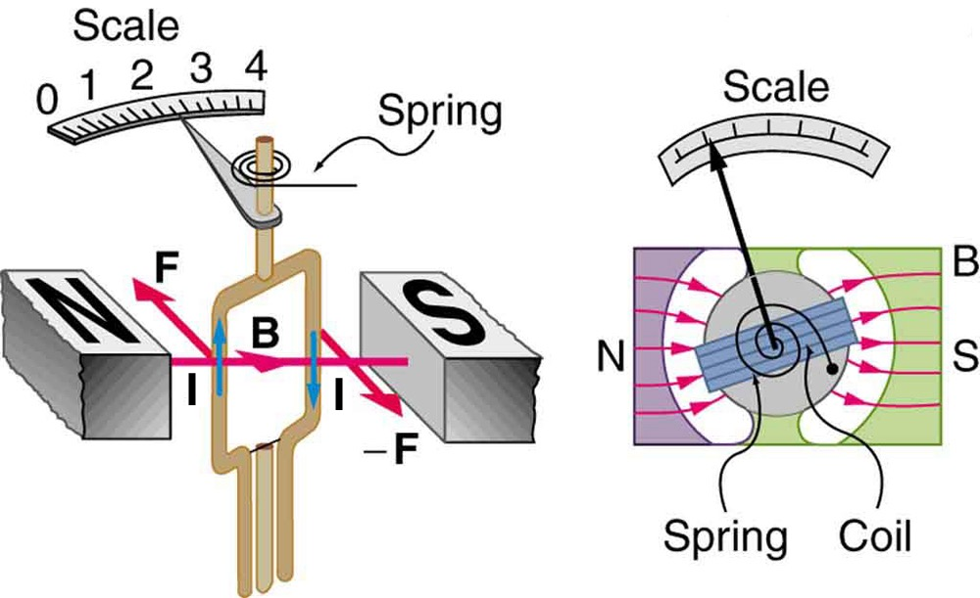
Deflection Torque

Slide 10
DEFLECTING TORQUE
The deflecting torque is produced by making one of the magnetic, heating, chemical, electrostatic and electromagnetic induction effect of current or voltage and cause the moving system of the instrument to move from its zero position.
The method of producing this torque depends upon the type of instrument.

Slide 11
CONTROLLING TORQUE
The magnitude of the moving system would be some what indefinite under the influence of deflecting torque, unless the controlling torque existed to oppose the deflecting torque.
When current flows, the springs wind up as the coil rotates, and the force they exert on the coil increases
The coil and pointer stop rotating when the controlling force becomes equal to the deflecting force.
It increases with increase in deflection of moving system.
Under the influence of controlling torque the pointer will return to its zero position on removing the source producing the deflecting torque.
Without controlling torque the pointer will swing at its maximum position & will not return to zero after removing the source.
Controlling torque is produced either by spring or gravity control.

Slide 12
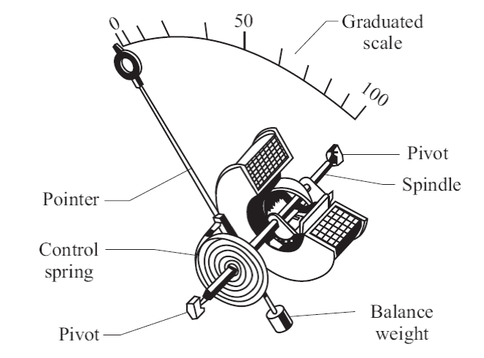
Single (Flat) Spring Control
Most commonly used.
One or two hairsprings made of phosphor bronze are used.
The outer end of this spring is fixed and the inner end is attached with the spindle.
When the pointer is at zero of the scale, the spring is normal.
As the pointer moves, the spring winds and produces an opposing torque.
The balance-weight balances the moving system so that its centre of gravity coincides with the axis of rotation, thereby reducing the friction between the pivot and bearings.
Next

Slide 13
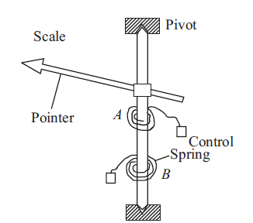
Double Spring Control
Spring Control:
Two springs A and B are wound in opposite directions.
On deflection, one spring winds while the other unwinds.
To make the controlling torque directly proportional to the angle of deflection, the springs should have fairly large number of turns.
The spring material must be nonmagnetic to avoid any magnetic field influence on the controlling force.
Since the springs are used to make electrical connection to the coil, they must have a low resistance.

Slide 14
Spring Control Cont…
Silicon-bronze, hard-rolled silver or copper, platinum-silver, platinum-iridium or German silver have been used as spring material
But most applications phosphor-bronze, owing to its properties, is the most suitable except in low resistance instruments (such as milli-voltmeters) where resistance of the spring is of considerable importance.
For moving coil instrument, where high sensitivity is desirable, the breadth of the spring should be 2 – 2.5 mm.
Flat spiral spring is usually rolled and drawn from wire, of such diameter that it will give the required breadth

Slide 15
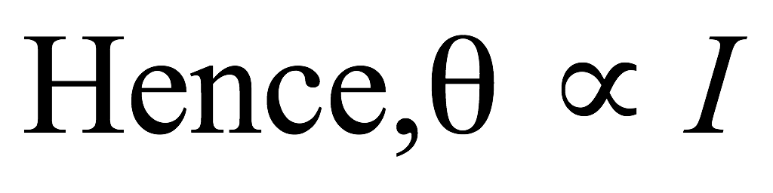
Springs Control Cont…
Advantages :
Since
These instruments have uniform scale.
Disadvantages :
The stiffness of the spring is a function of temperature.
Hence, the readings given by the instruments are temperature dependent.
Furthermore, with the usage the spring develops an inelastic yield which affects the zero position of the moving system.
Next

Slide 16
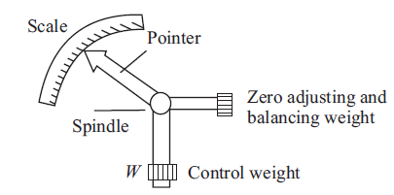
Gravity Control
In gravity controlled instruments, a small adjustable weight is attached to the spindle of the moving system such that the deflecting torque produced by the instrument has to act against the action of gravity.
Thus a controlling torque is obtained. This weight is called the control weight. Another adjustable weight is also attached is the moving system for zero adjustment and balancing purpose. This weight is called Balance weight.

Slide 17
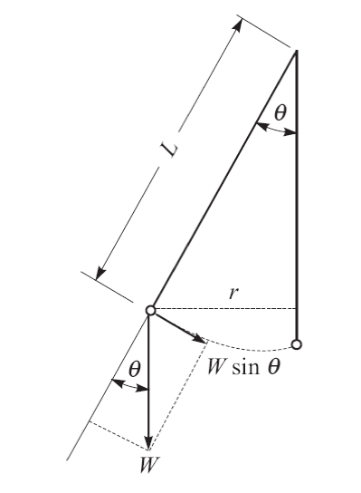
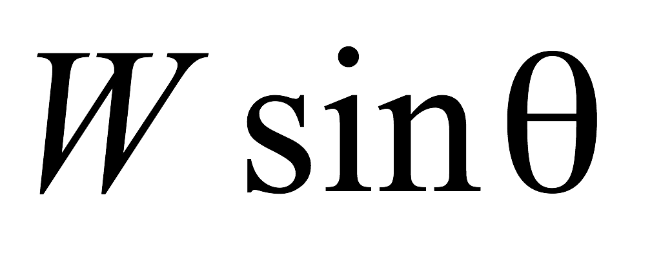
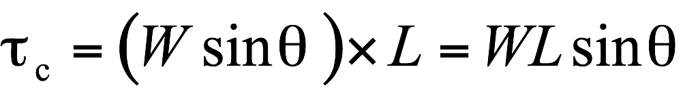
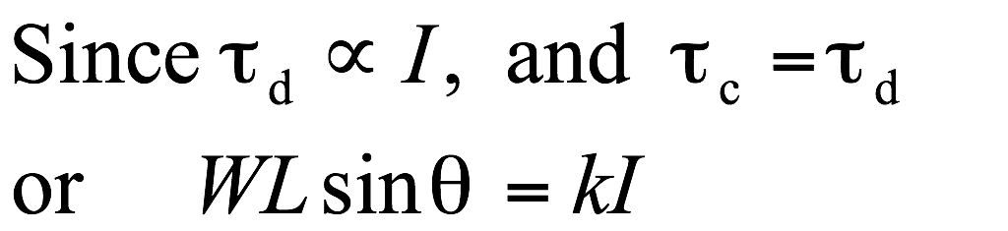
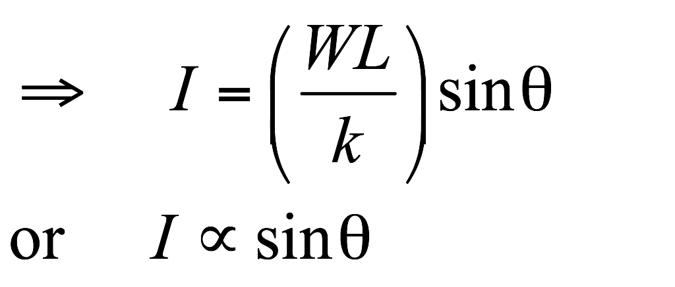
Gravity Control Cont…
When deflected by an angle θ, the weight exerts a force,
The restraining or controlling torque developed is given as
Next

Slide 18
Gravity Control Cont…
Disadvantage :
These do not have uniform scale.
These must be used in vertical position so that the control may operate properly.
Advantages :
Less expensive.
Unaffected by changes in temperature.
Free from fatigue or deterioration with time.
Next

Slide 19
DAMPING TORQUE
We have already seen that the moving system of the instrument will tend to move under the action of the deflecting torque.
But on account of the control torque, it will try to occupy a position of rest when the two torques are equal and opposite.
However, due to inertia of the moving system, the pointer will not come to rest immediately but oscillate about its final deflected position as shown in figure and takes appreciable time to come to steady state.
To overcome this difficulty a damping torque is to be developed by using a damping device attached to the moving system.

Slide 20
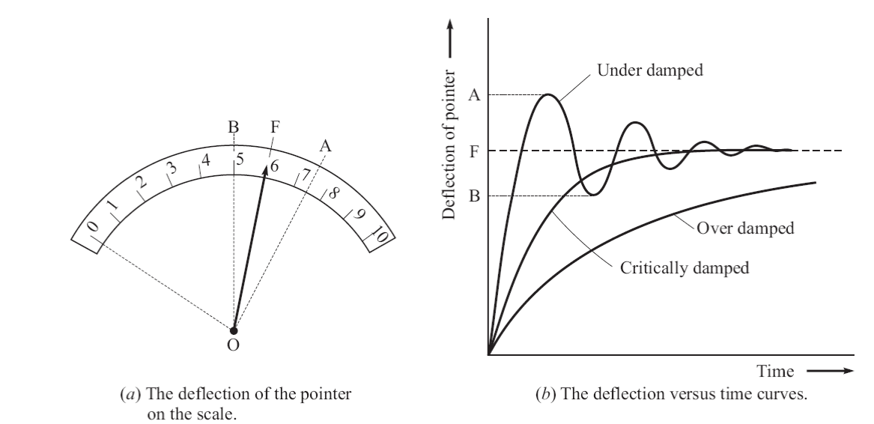
Damping Torque Cont…
Next

Slide 21
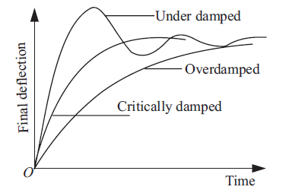
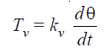
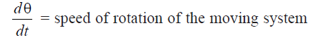
DAMPING TORQUE Cont…
The damping torque is proportional to the speed of rotation of the moving system, that is
Depending upon the degree of damping introduced in the moving system, the instrument may have any one of the following conditions as depicted in above graph.

Slide 22
DAMPING TORQUE Cont…
Over-damped Condition: The time-delay in taking the reading becomes unnecessarily long.
Under damped Condition: The response is oscillatory. The oscillations of the pointer would not be killed completely.
Thus, the damping torque should be just sufficient to kill the oscillation without increasing the delay-time.
This condition is said to be critically damped or ‘dead beat’. The response settles quickly without any oscillation.
Methods of Damping:
1.Air Friction Damping 2.Fluid Friction Damping
3.Eddy Current Damping 4.Electromagnetic Damping

Slide 23
Types of Damping
[Eddy Current Damping]
When a sheet of conducting material moves in a magnetic field so as to cut through lines of force, eddy currents are set up in it and a force exists between these currents and the magnetic field, which is always in the direction opposing the motion.
This force is proportional to the magnitude of the current, and to the strength of field.
The current is proportional to the velocity of movement of the conductor, and thus, if the magnetic field is constant, the damping force is proportional to the velocity of the moving system and is zero when there is no movement of the system

Slide 24
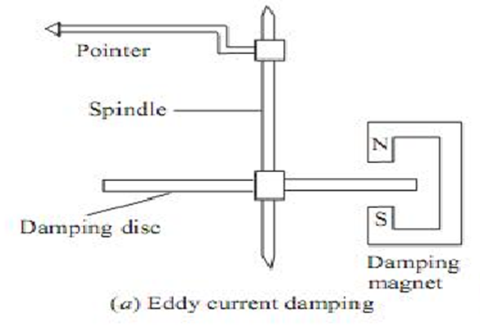
Eddy Current Damping Torque with a Metal Disc
Thin disc of conducting, but non-magnetic material-usually copper of aluminium is mounted on the spindle which carries the pointer of the instrument.
When the spindle rotates, the edge of the disc cuts through the lines of force in the gap of a permanent magnet, and eddy currents, with consequent damping, are produced.

Slide 25
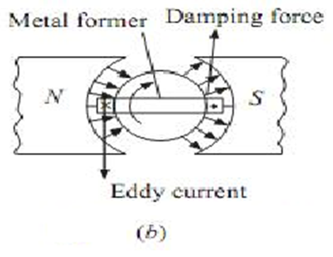
Eddy Current Damping Torque with a Metal Former
The essential parts of a PMMC instrument.
The coil is wound on a light metal former in which eddy currents are induced when the coil moves in the permanent-magnet field.
The directions of the eddy-current which in turn produce the damping torque due to the motion of the coil (clockwise) are as shown in the figure and this will produce damping forces as indicated in the figure.

Slide 26
Errors: Eddy Current Damping
The common errors are on account of
friction,
change in temperature,
mechanical unbalances and
variation of the electrical and mechanical properties of the materials employed with time.

Slide 27
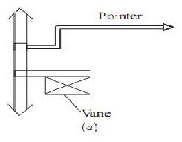
Air Friction Damping
Light Vane/Vanes with considerable area attached to the moving system displace air and develop a frictional force opposing the motion.
Figure shows a light aluminum vane which moves in a quadrant (sector) shaped air chamber.
The chamber also carries a cover plate at the top. The vane is mounted on the spindle of the moving system.
The aluminum vane should not touch the air-chamber walls otherwise a serious error in the deflection of the instrument will be introduced.
Now, with the motion, the vane displaces air and thereby a damping force is created on the vane that produces a torque (damping) on the spindle.

Slide 28
Air Friction Damping
The air friction damping is very simple and cheap. But care must be taken to ensure that the piston is not bent or twisted. This method is used in moving iron and hot wire instruments.

Slide 29
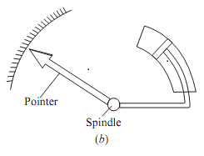
Air Friction Damping
Figure consists of a light aluminum piston which is attached to the moving system.
This piston moves in a fixed chamber which is closed at one end.
Either circular or rectangular chamber may be used.
The clearance (or gap) between the piston and chamber walls should be uniform throughout and as small as possible.
When the piston moves rapidly into the chamber the air in the closed space is compressed and the pressure of air thus developed opposes the motion of the piston and thereby the whole moving system.

Slide 30
Fluid Friction Damping
This form of damping is similar to air friction damping.
The action is the same as in the air friction damping.
Mineral oil is used in place of air and as the viscosity of oil is greater, the damping force is also much greater.
The vane attached to the spindle is arranged to move in the damping oil.
It is rarely used in commercial type instruments.

Slide 31
Fluid Friction Damping Cont…
The oil used must fulfill the following requirements:
It should not evaporate quickly.
It should not have any corrosive effect on metals.
Its viscosity should not change appreciably with temperature.
It should be good insulator.

Slide 32
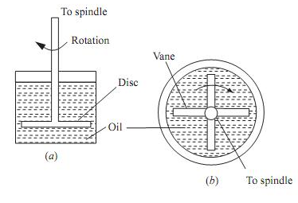
Fluid Friction Damping Cont…
In Fig. (a) a disc attached to the moving system is immersed in the fluid (damping oil).
When the moving system moves the disc moves in oil and a frictional drag is produced.
For minimizing the surface tension affect, the suspension stem of the disc should be cylindrical and of small diameter.
In the arrangement of Fig. (b) a number of vanes are attached to the spindle.
These vanes are submerged in oil and moves in a vertical plane.
This arrangement provides greater damping torque.

Slide 33
Fluid Friction Damping
Advantages
The oil used for damping can also be used for insulation purpose in some forms of instruments which are submerged in oil.
The clearance between the vanes and oil chamber is not as critical as with the air friction damping system.
This method is suitable for use with instruments such as electrostatic type where the movement is suspended rather than pivoted.
Due to the up thrust of oil, the loads on bearings or suspension system is reduced thereby reducing the frictional errors.
Disadvantages
The instruments with this type of damping must be kept always in a vertical position.
It is difficult to keep the instrument clean due to leakage of oil.
It is not suitable for portable instruments.

Slide 34
LECTURE 3 B (Part 1)
MOVING COIL and MOVING IRON INSTRUMENTS

Slide 35
MOVING COIL INSTRUMENTS
There are two types :
(1) Permanent Magnet Type : It is the most accurate and useful for dc measurements.
(2) Dynamometer Type : It can be used for both dc and ac measurements.
Next

Slide 36
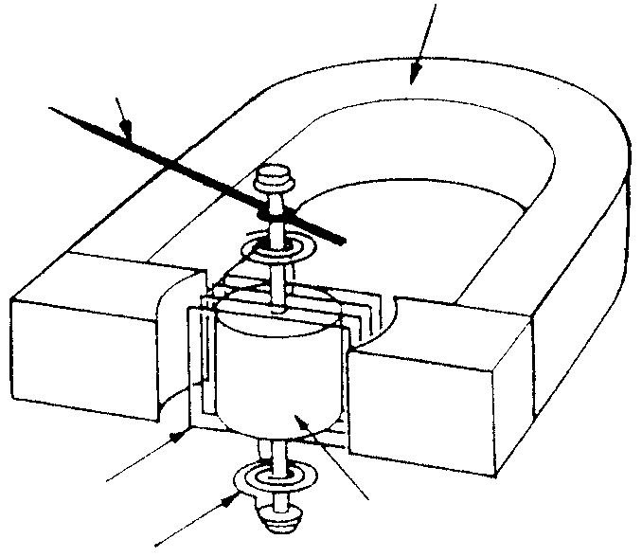
Permanent Magnet Moving Coil (PMMC) meter
Permanent magnet
Pointer
Moving coil
Iron core
Spring

Slide 37
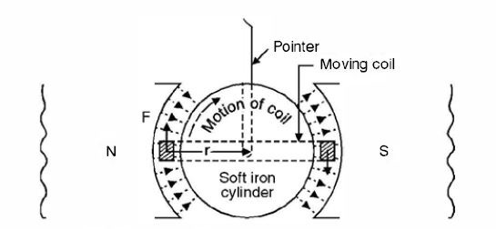
Permanent Magnet Type
When a current carrying conductor is brought in a magnetic field (they should not be parallel to each other) a torque on the conductor is produced.
The instrument consists of a rectangular coil pivoted so that its sides lie in the air gap between the two poles of a permanent magnet and a soft-iron cylinder.

Slide 38
Permanent Magnet Type
The air gap between the magnet poles and iron core is small and the flux density is uniform and is in a radial direction, so that the flux lines are always at right angle to the current carrying conductor and hence when current passes through the coil, a deflecting torque is produced owing to the interaction between the two fluxes, one due to permanent magnet and the other due to the magnetic field of the coil.

Slide 39
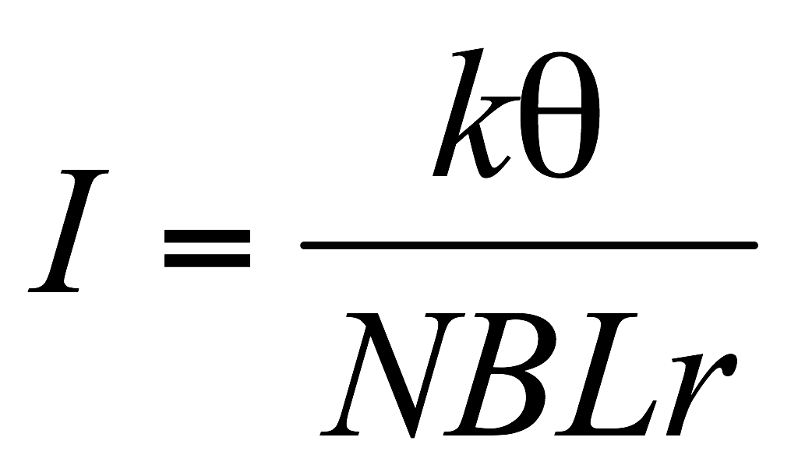
There are three main torques acting on the moving mechanism.
Deflecting Torque
Controlling Torque
Damping Torque
A pointer is attached to the moving mechanism to show the reading.
In case of PMMC instruments spring made of phosphor bronze provides control torque.
The spring also serves as leads to the moving coil.
When deflecting torque acts on the coil, both the control torque and damping torques come into action.
The control torque restrains the rotation of the coil whereas the deflecting torque tries to rotate the coil.

Slide 40
Now, if N is the no. of turns in the coil, B the magnetic flux density due to permanent magnet, I the current in the coil, L the effective length, the force acting on the coil is given by
F = NBIL Newton
Hence the torque on the coil is
T = NBIL.r N-m
From the above equation it is obvious that if the flux density in the air gap is constant, then
Deflecting torque, T_{d} α I
Since such instrument are spring controlled,
Controlling torque, Tc α θ (deflection)
Since in steady deflection position
Tc = Td → θ α i

Slide 41
At balance, if the coil has moved through an angle θ and if k is the spring constant, we have,
NBIL . r = kθ
Hence
And so you can have a uniform/linear scale.

Slide 42
Advantages :
(i) High sensitivity.
(ii) Uniform scale.
(iii) Well shielded from any stray magnetic field.
(iv) High torque/weight ratio.
(v) Effective and reliable eddy-current damping.
(vi) Low power consumption
(vi) Used with shunt and resistance to cover a large range of both currents and voltages
(vii) Freedom from errors due to stray magnetic fields.
Disadvantages :
(i) Cannot be used for ac measurement.
(ii) More expensive compared to moving-iron type.
(iii) Ageing of control springs and of the permanent magnets might cause errors.

Slide 43
Dynamometer Type Moving Coil Instruments
Permanent magnet is replaced by one or two fixed coils which carry current to be measured or a current proportional to the voltage to be measured and which are connected either in series or parallel with the moving coil.
The coils are usually air cored.
The torque of the instrument is dependent upon the magnetic field strengths of the fixed and moving coil i.e. the torque is proportional to square of the current in an ammeter and square of the voltage in a voltmeter.

Slide 44
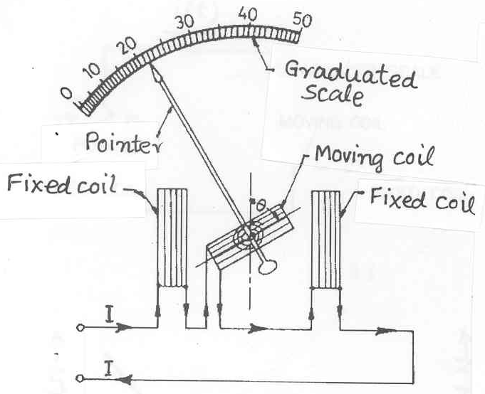
DYNAMOMETER TYPE INSTRUMENTS

Slide 45
Dynamometer Type Moving Coil Instruments
Dynamometer instruments can thus be used in alternating current circuits for which square law is essential.
Since energy must be used to create two magnetic fields, the electrodynamometer movement is less sensitive as compared to that in PMMC instruments.
The control torque is provided by spring torque.
The damping is provided by either eddy currents or air piston attached to the pointer.

Slide 46
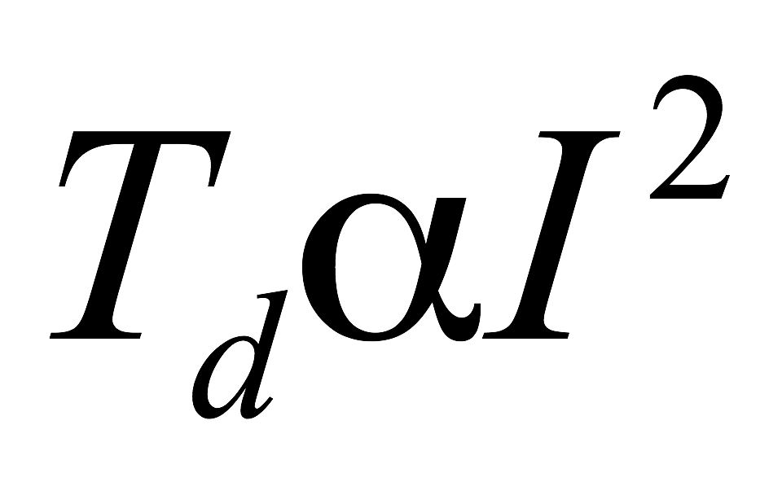
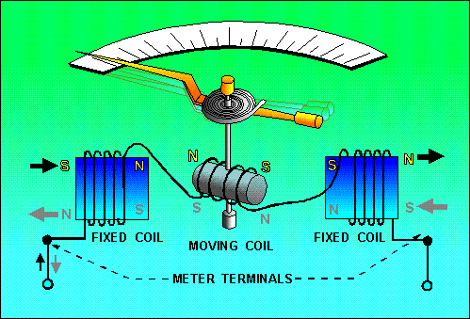
These instruments are not in common use as
(a) They have low torque/weight ratio
(b) Owing to , the scale is non uniform
(c) These are expensive.
Dynamometer/electrodynamic meter movement

Slide 47
Errors in Dynamometer type Instruments
Frictional Error
Temperature Error
Error due to stray magnetic fields
Frequency Error

Slide 48
Applications
Ammeter and Voltmeter
For the measurement of small currents (5 to 100mA) the instrument would be arranged to have the fixed and moving coils connected in series.
For measuring larger currents (up to 20 A) it becomes impracticable to pass the full value of current through the moving coil, so is then shunted by low resistance.
Its usually better to use current transformers and an ammeter with an full scale deflection of 5 A.

Slide 49
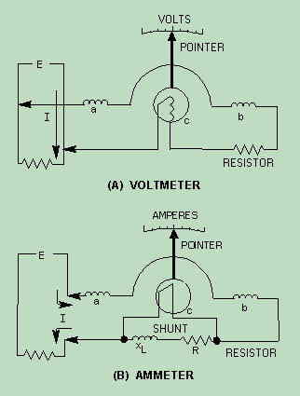
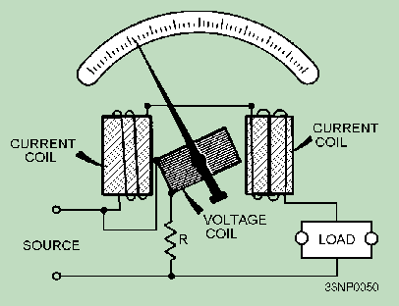
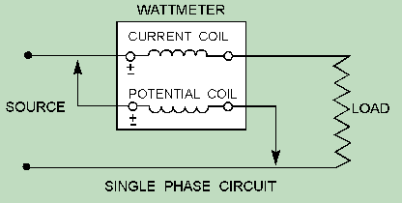
Circuit arrangement of electrodynamometer for use as a voltmeter an ammeter and wattmeter.

Slide 50
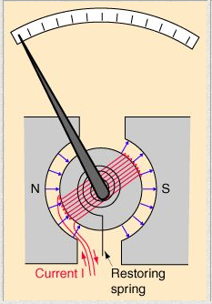
Galvanometers
When a current is passed through a coil in a magnetic field, the coil experiences a torque proportional to the current.
A coil spring provides the controlling torque.
The deflection of a needle attached to the coil is proportional to the current.
Such "meter movements" are at the heart of the moving coil meters such as voltmeters and ammeters.
Now they were largely replaced with solid state meters.
Next

Slide 51
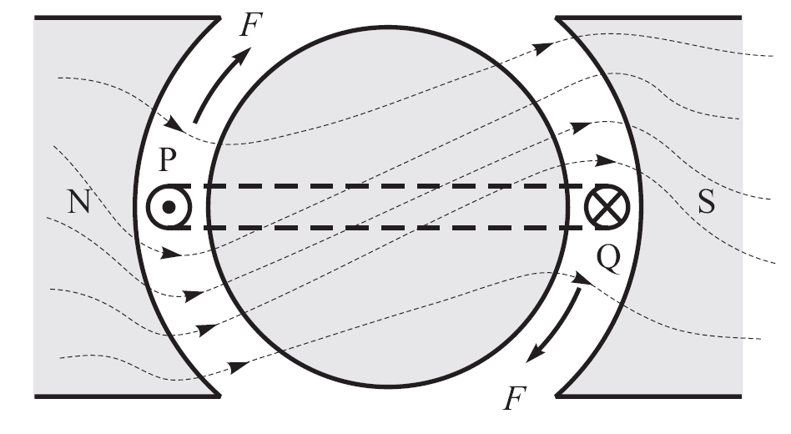
How the Deflection Torque is Produced
Consider a single turn PQ of the current carrying coil.
The outward current in P set up a counterclockwise magnetic field.
Thus, the field on the lower side is strengthened and on upper side weakened.

Slide 52
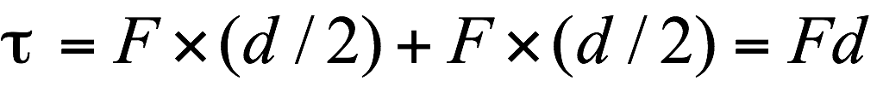
How the Deflection Torque is Produced
The inward current in Q, on the other hand, strengthens the field on the upper side while weakens it on the lower side.
The coil experience forces F-F.
If d is the width of the coil

Slide 53
INSTRUMENT RANGE EXTENSION

Slide 54
AMMETERS AND VOLTMETERS
Consider a d’Arsonval movement having current sensitivity (CS) of 0.1 mA and internal resistance (R_{m}) of 500 Ω.
The full-scale deflection current, I_{m}, for this instrument is 0.1 mA.
When full-scale current flows, the voltage across its terminals is given as
So, it can serve either as an ammeter of range 0 - 0.1 mA, or as a voltmeter of range 0 - 50 mV.
We need to extend the range of the meter, by providing a suitable additional circuitry.
Next

Slide 55
Ammeters
Connected in series in circuits.
Low impedance (resistance) so as not to affect the circuit.
Constructed by adding a low resistance (or shunt or bypass resistor) in parallel with the meter.
M
Ammeter
Next

Slide 56
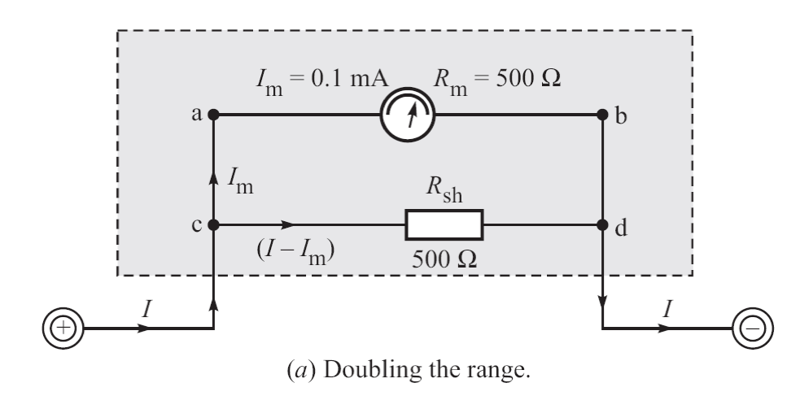
Ammeters
Next

Slide 57
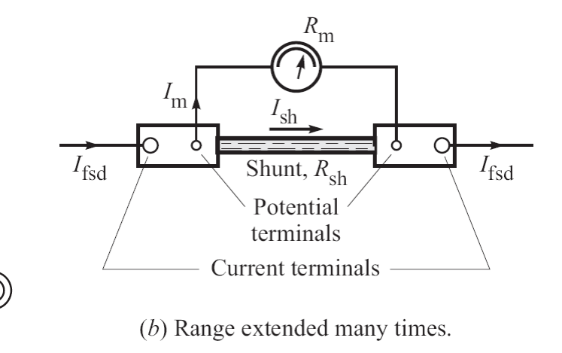
The ratio I_{fsd}/I_{m} = N is called the range-multiplier.
Next

Slide 58
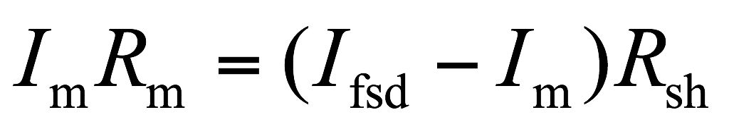
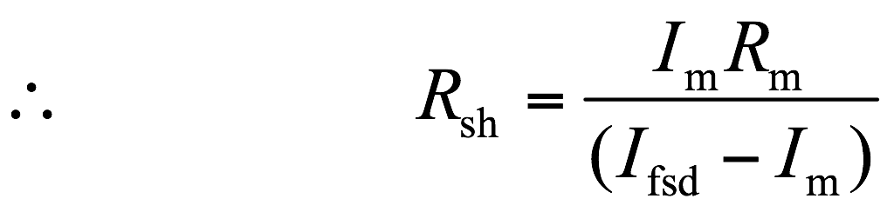
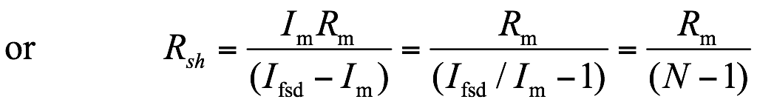
Since the voltage across the parallel elements must be the same,
Click
Next

Slide 59
Ammeter Example
An ammeter uses a meter with an internal resistance of 600 Ω and a rating of 1 mA fsd. How can it be used to measure 20 A fs?
i_{m}
Maximum current through meter is 0.001 A.
Therefore, the shunt resistor must take 19.999 A
R_{M}
M
R
i_{R}
Because both M and R are in parallel, the same V must be dropped across both
V = I_{m} R_{m} = 0.001 A x 600 Ω = 0.6 V
Thus R must be V / I_{R} = 0.6 V / 19.99 A = 0.03 Ω (in parallel.)

Slide 60
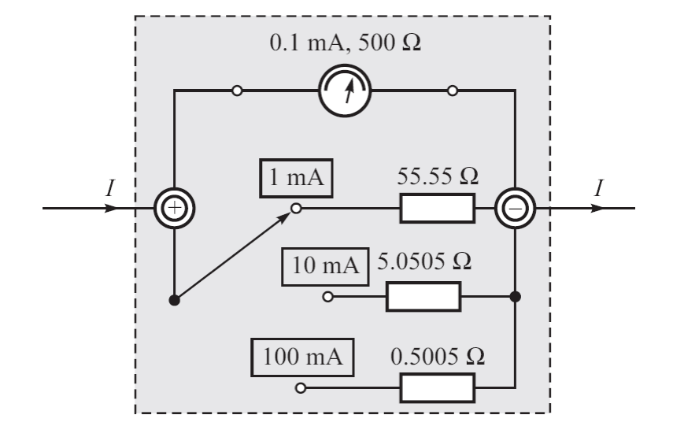
A multi-range ammeter.
Next

Slide 61
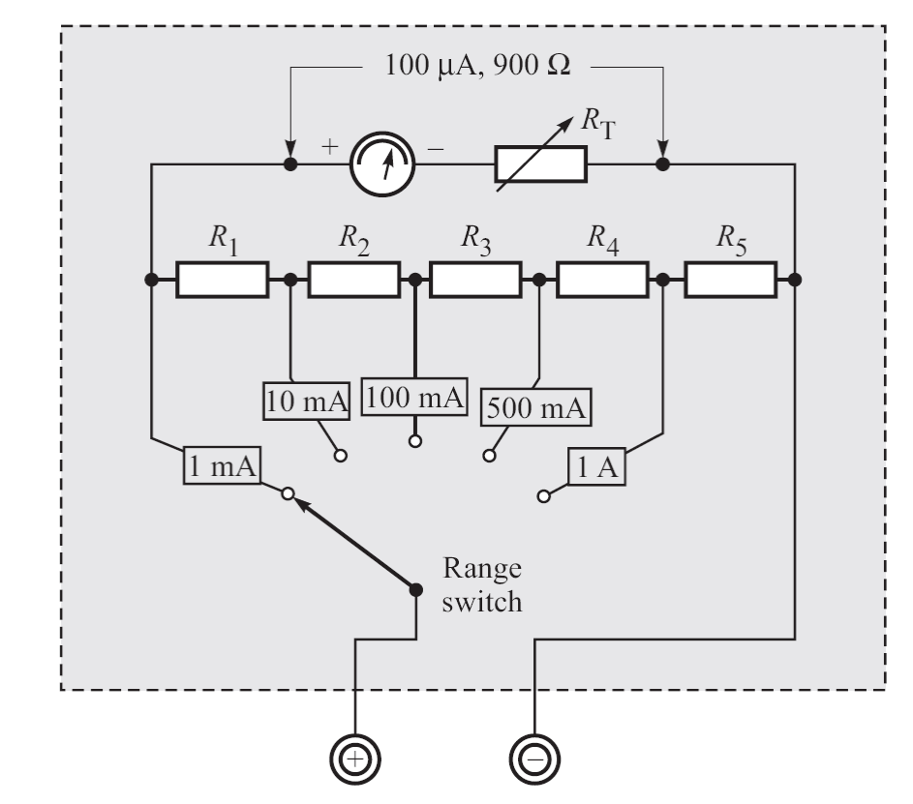
Universal shunt for multi-range milliammeter
Next

Slide 62
Ammeter Sensitivity
Measured in ohms/amp; should be as low Ω/A (small V drop) as possible.
Sensitive ammeters need large indicator changes for small current.
Example : (1) A 0.01 Ω/A meter with 5 A fsd,
R_{m} = Ω/A x A = 0.01 x 5 = 0.05 Ω
V_{max} across the Meter will be 5 A x 0.05 Ω = 0.25 V for fs.
(2) A 0.1 Ω/A meter with 5 A fsd, will drop 2.5 V (i.e., it is 10 times less sensitive), which may bias the results.

Slide 63
Ammeter loading
Significant where ammeters are used in circuits with components of resistance comparable to that of the meter.
1.0 Ω
What is the current in the circuit ?
+
1.0 V
A
-
Is it i = 1 V / 1 Ω = 1 A ?
Next

Slide 64
Now, suppose that the meter has a resistance of 1 Ω.
How much will be current in the circuit ?
Obviously, the current in the circuit will be halved !
Click
When working with low value resistors, be sure to use very low impedance ammeters.
Next

Slide 65
Voltmeters
Connections to circuits and components in parallel.
High impedance (resistance) so as not to affect circuit.
Constructed by adding a high resistance (R) in series with an electrically sensitive meter (M).
M
R
Voltmeter
Next

Slide 66
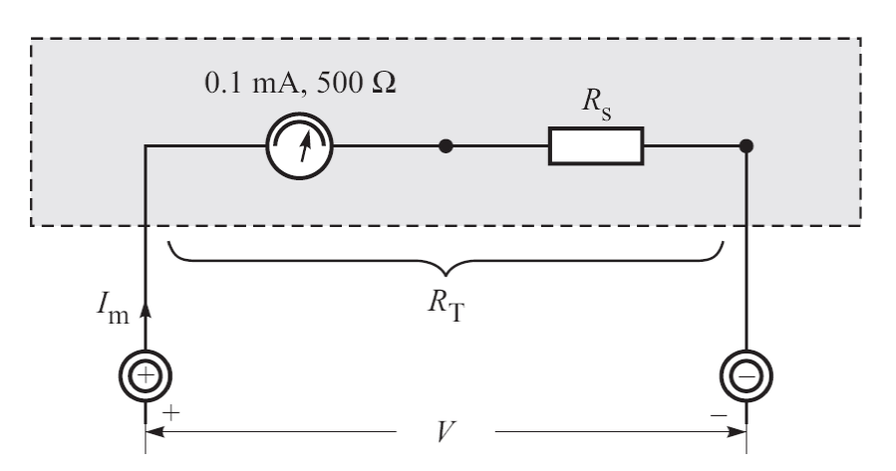
Extending the Range of Voltmeters
Suppose that we want to extend the voltage range of this basic meter to 0-10 V.
Next

Slide 67
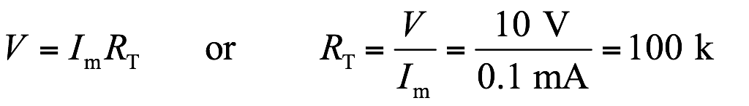
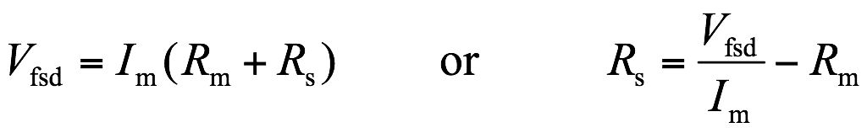
The total resistance R_{T} must be such that
Now, suppose that the range of a basic meter is to be extended to V_{fsd} volts. Then, we should have
The series resistor R_{s} is also called a range-multiplier, as it multiplies the voltage range.
Next

Slide 68
Example 4
A meter is rated at 1 mA fsd and has an internal resistance of 2000 Ω. How can it be used to measure 100 V fsd ?
Solution :
M
1 mA
R_{m}
R_{s}
V_{m} = 2 V
V_{s} = 98 V
R_{T} = R_{s} + R_{m}
Maximum voltage that can be put across galvanometer is V_{m} = I R_{m} = 0.001 x 2000 = 2.0 V Thus, V_{s} = V_{T} - V_{m} = 100 V - 2 V = 98 V
This voltage must be dropped across R_{s}. Therefore,
R_{s} = V_{s}/I = 98 V / 0.001 A = 98 kΩ

Slide 69
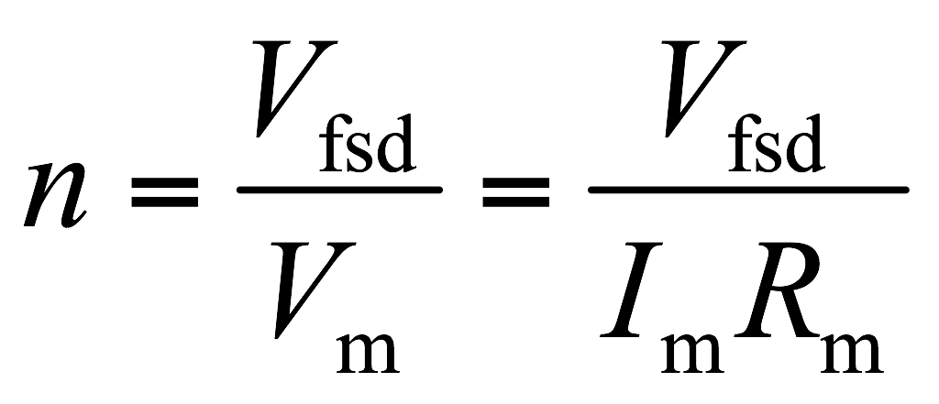
Voltage Scaling or Multiplying Factor
It is defined as the number of times the voltage range is increased. Thus,
Next

Slide 70
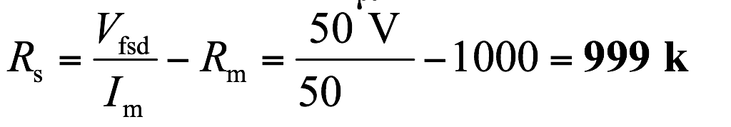
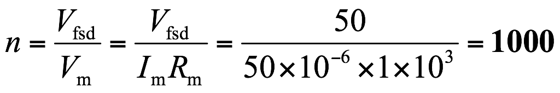
Example 5
A 50-μA meter movement with an internal resistance of 1 kΩ is to be used as a dc voltmeter of range 50 V. Calculate
(a) the multiplier resistance needed, and
(b) the voltage multiplying factor.
Solution : Here, I_{m} = 50 μA, and R_{m} = 1 kΩ.
(a) The series resistance needed is given as
(b)

Slide 71
Meter Sensitivity (Ohms-per-Volt Rating)
Measured in Ω/V.
Higher the sensitivity, more accurate is the measurement.
If current sensitivity (CS) of a meter is known, its Ω/V rating can easily be determined.
Consider a basic meter with CS of 100 μA.
If used as a voltmeter of range 1 V,
R_{T} = 1 V / 100 μA = 10 kΩ
Thus, the meter sensitivity is simply 10 kΩ/V.

Slide 72
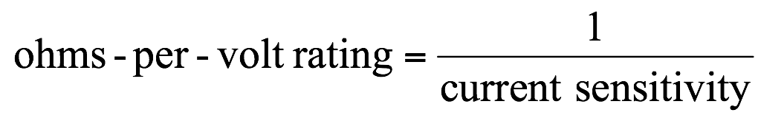
In general,
Note that if the same meter was used for 2 V range, the required R_{T} would be 20 kΩ.
Its ohms/volt rating is 20 kΩ / 2 V = 10 kΩ/V.
The ohms-per-volt rating does not depend on the range of the voltmeter.
Next

Slide 73
Also, note that the range of a voltmeter (or an ammeter) is changed by switching in another resistor in the circuit.
Therefore, for a given range the internal resistance of the voltmeter remains the same irrespective of the deflection of the pointer.
Next

Slide 74
Voltmeter Loading
A voltmeter, when connected, acts as a shunt for that portion of the circuit.
This reduces the resistance of that portion.
Hence, the meter gives a lower reading.
This effect is called the loading effect of the meter.
Next

Slide 75
Example 6
It is desired to measure the voltage across the 50-kΩ resistor in the circuit.
Two voltmeters are available for this measurement. Voltmeter-A has a sensitivity of 1000 Ω/V and voltmeter-B has a sensitivity of 20 000 Ω/V.
Both meters are used on their 50-V range.
Calculate
(a) the reading of each meter, and
(b) the error in each reading, expressed as a percentage of the true value.

Slide 76
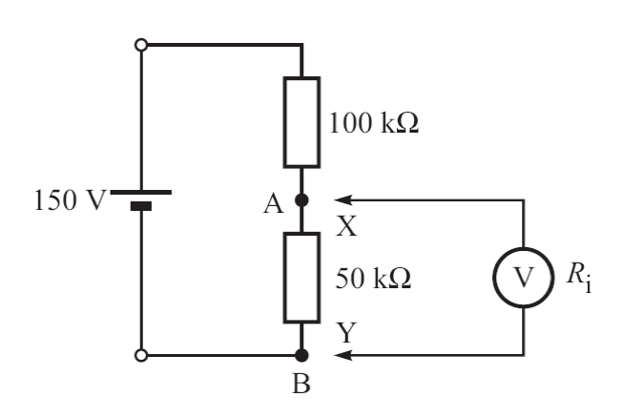

Solution :
The true value of the voltage across A-B,
Next

Slide 77


(a) Voltmeter-A
Click
The internal resistance,
When connected, the equivalent parallel resistance across A-B is 50 kΩ || 50 kΩ = 25 kΩ. Hence, reading of voltmeter,
Click
Voltmeter-B
Click
Next

Slide 78


(b) Error in reading of Voltmeter-A,
Error in reading of Voltmeter-B,
Click
Note the voltmeter with higher sensitivity gives more accurate results, since it produces less loading effect on the circuit.
Next

Slide 79

MOVING IRON INSTRUMENTS
There are two types: (b) the attraction type (c) the repulsion type.

Slide 80


MOVING IRON INSTRUMENTS
The measured current is connected to the stationary coil and the magnetic field generated by this coil interacts with the moving iron element.
The iron vane changes its location as to increase the magnetic flux flowing through it.
This causes at attraction in the attraction type and a repulsion between the fixed and movable iron element in the repulsion type.
The angular deflection depends on the measured current I and the change of the inductance dL caused by this deflection.
Although the deflection is a nonlinear function of measured current it is possible to design the device (the component $\frac{dL}{dα}$) in such a way that the expression $\left(\frac{dL}{dα}I^{2}\right)$ is close to linear.

Slide 81
MOVING IRON INSTRUMENTS
Advantages
The instruments are simple, cheap, reliable and robust.
Simplicity of the design – no need to supply the moving element
Easy change of the range by selecting the number of the turns in the coil
The instruments can be used on a.c and d.c.
Disadvantages
It has relatively large power consumption (0.1 – 1VA)
Small Sensitivity (in comparison with moving coil instruments)
They cannot be calibrated with high degree of precision with D.C on account of the effect of hysteresis in the iron rods or vanes
Frequency bandwidth is limited to 150Hz.

Slide 82

MOVING IRON INSTRUMENTS – ATTRACTION TYPE
Principle
A soft iron piece gets magnetized when it is brought into a magnetic field produced by a permanent magnet.
The same phenomenon happens when the soft iron piece is brought near either of the ends of a coil carrying current.
The iron piece is attracted towards that portion where the magnetic flux density is more.
This movement of soft iron piece is used to measure the current or voltage which produces the magnetic field.

Slide 83
MOVING IRON INSTRUMENTS – ATTRACTION TYPE
A soft iron disc is attached to the spindle
To the spindle, a pointer is also attached, which is made to move over calibrated scale
The moving iron is pivoted such that it is attracted towards the center of the coil where the magnetic field is maximum

Slide 84
MOVING IRON INSTRUMENTS – ATTRACTION TYPE
When the current to be measured is passed through the coil or solenoid, field is produced which attracts the eccentrically mounted disc inwards, thereby deflection the pointer which moves over a calibrated scale

Slide 85
MOVING IRON INSTRUMENTS – ATTRACTION TYPE
[Deflecting Torque]
Produced by the current or the voltage to be measured.
It is proportional to the square of the voltage or current.
Hence, the instrument can be used to measure d.c. or a.c.
Scale is non- uniform
Control torque : Spring or gravity
Damping : Air friction damping

Slide 86


MOVING IRON INSTRUMENTS – REPULSION TYPE
Two iron piece kept with close proximity in a magnetic field get magnetized to the same polarity. Hence, a repulsive force is produced.
If one of the two piece is made movable, the repulsive force will act on it and move it on to one side.
This movement is used to measure the current or voltage which produces the magnetic field.

Slide 87
MOVING IRON INSTRUMENTS – REPULSION TYPE
Construction:
There are two iron pieces-fixed and moving.
The moving iron is connected to the spindle to which is attached a pointer. It is made to move over a calibrated scale.

Slide 88
MOVING IRON INSTRUMENTS – REPULSION TYPE
When the current to be measured is passed through the fixed coil it sets up its own magnetic field which magnetizes the two rods similarly the adjacent points on the lengths of the rods will have the same magnetic polarity.
Hence, they repel each other with the result that the pointer is deflected against the controlling torque of a spring or gravity.
The force of repulsion is approximately proportional to the square of the current passing through the coil
Whatever be the direction of current in the coil, the two irons are always similarly magnetised.

Slide 89
MOVING IRON INSTRUMENTS – REPULSION TYPE
[Deflecting Torque]
Produced by the current or the voltage to be measured.
It is proportional to the square of the voltage or current.
Hence, the instrument can be used to measure d.c. or a.c.
Control torque : Spring or gravity
Damping : Air friction damping

Slide 90
HOT-WIRE AND THERMOCOUPLE METER MOVEMENTS
Both use the heating effect of current flowing through a resistance to cause meter deflection.
Each uses this effect in a different manner.
Since their operation depends only on the heating effect of current flow, they may be used to measure both d.c. and a.c. of any frequency on a single scale.
The effective value which is average in d.c. and r.m.s. in a.c.

Slide 91

HOT WIRE TYPE
Deflection depends on the expansion of a high-resistance wire caused by the heating effect of the wire itself as current flows through it.
A resistance wire is stretched taut between the two meter terminals, with a thread attached at a right angle to the center of the wire.
A spring connected to the opposite end of the thread exerts a constant tension on the resistance wire.
Current flow heats the wire, causing it to expand.
This motion is transferred to the meter pointer through the thread and a pivot.

Slide 92

Thermocouple Meter
Consists of a resistance wire across the meter terminals, which heats in proportion to the amount of current.
Attached to this wire is a small thermocouple junction of two unlike metal wires, which connect across a very sensitive dc meter movement (usually a d’Arsonval meter movement).
As the current being measured heats the heating resistor, a small current (through the thermocouple wires and the meter movement) is generated by the thermocouple junction.
The current being measured flows through only the resistance wire, not through the meter movement itself.
The pointer turns in proportion to the amount of heat generated by the resistance wire.

Slide 93
INDUCTION TYPE INSTRUMENT
Such instruments are suitable for ac measurements only in these instruments the deflecting torque is produced by the eddy currents induced in an aluminum or copper disc or drum by the flux created by an electro-magnet.
The main advantages of such instruments are that
(i) a full scale deflection can be obtained giving long and open scale
(ii) the effect of stray magnetic field is small;
(iii) damping is easier and effective.

Slide 94
INDUCTION TYPE INSTRUMENT
These instruments have got some serious disadvantages
(i) The greater deflection causes more stresses in the control springs.
(ii) Variation in supply frequency and temperature may cause serious errors unless compensating device is employed.
(iii) These instruments are costlier and consume more power
Such instruments are mostly used as watt-meters or energy meters.

Slide 95

INDUCTION TYPE INSTRUMENT
Induction type wattmeter consists of two laminate electromagnets known as shunt electromagnet and series electromagnet respectively.
Shunt magnet is excited by the current proportional to the voltage across load flowing through the pressure coil and series magnet is excited by the load current flowing through the current coil.
A thin disc made of Cu or Al, pivoted at its centre, is placed between the shunt and series magnets so that it cuts the flux from both of the magnets.

Slide 96
INDUCTION TYPE INSTRUMENT
The deflection torque is produced by interaction of eddy current induced in the disc and the inducing flux in order to cause the resultant flux in shunt magnet to lag in phase by exactly 90° behind the applied voltage.
One or more copper rings, known as copper shading bond are provided on one limb at the shunt magnet.
Correct disappointed between shunt and series magnet fluxes may be attained by adjusting the position of copper shading bonds.
The pressure coil circuit of induction type instrument is made as inductive as possible so that the flux of the shunt magnet may lag by 90° behind the applied voltage.

Slide 97
LECTURE 3 B (Part 2)
MEASUREMENT OF ENERGY/POWER

Slide 98
Single Phase Power(Energy) Measurement
D.C. Power measurements
Dynamometer method
Ammeter-Voltmeter Method
Hall-power meter
A.C. Power Measurement (Single Phase)
Ammeter-Voltmeter Method
Dynamometer method
Hall-power meter
Three Voltmeter Method
Three Ammeter Method
A.C. Power Measurement (Single Phase)
Three-phase systems
High-frequency power measurements
Energy measurements
DC circuits
AC circuits

Slide 99

Power in DC circuits
Power
Can be carried out using a voltmeter and an ammeter (generally)
Ammeter-Voltmeter method
Two measurement arrangements
Wattmeters:
Dynamometer
Thermal wattmeter
Hall-power meter
Three Voltmeter Method
Three Ammeter Method

Slide 100


Electrodynamic meters – Wattmeters
The electrodynamic meters were formerly the most accurate indicating instrument.
Today for accurate measurements these instruments are substituted by the digital devices.
The electrodynamic devices are still used as wattmeters.

Slide 101

Electrodynamic meters – Wattmeters
The torque M resulting from the interaction between two coils depends on currents: I1 in stationary coil, I2 in movable one and the phase shift between these currents:
$$M cI_{1}I_{2} cos(φ)$$
Thus if one coil is connected to the current and the second to the voltage we can directly measure the power, because $P=UIcosφ$

Slide 102


Electrodynamic meters – Wattmeters
In the voltage circuit there is usually introduced a series resistor Rd. Thus the torque can be calculated from the following equation:
$M=\frac{c}{R_{d}}UIcosφ= k∙P$

Slide 103

Pwer in DC Circuits: Ammeter and Voltmeter Method
Two main arrangements:
Ammeter measures current which flow into the voltmeter and load.
Voltmeter measures voltage drop across the ammeter in addition to that dropping across the load.

Slide 104

Pwer in DC Circuits: Ammeter and Voltmeter Method
Correction

Slide 105
Pwer in DC Circuits: Ammeter and Voltmeter Method
Correction

Slide 106


Hall-power meter
Coil generates magnetic field which is proportional to load current
The sensor excitation current passes through R1 and is proportional to the load voltage.
→ Hall voltage is proportional to load power
Problems: offset and linearity.

Slide 107
Power (Energy) in AC circuits
Can be measured:
Ammeter-Voltmeter Method
Dynamometer
Hall Effect Meter
Thermal Meters
Three Voltmeter Method
Three Ammeter Method

Slide 108





Power (Energy) in AC circuits
Instantaneous power (time dependence)
Mean power (usually the most interesting)
Real power (active work), reactive power, apparent power
Measures can be done same way as DC circuit (single-phase)

Slide 109


Low- and Medium-Frequency Power Measurements
Three-Voltmeter Method
Single-phase arrangements
Power in load can be measured using a non-inductive resistor and measuring the three voltage
Also in DC circuits

Slide 110



Low- and Medium-Frequency Power Measurements
Three-Ammeter Method
Single-phase arrangements
Power in load can be measured using a non-inductive resistor and measuring the three currents
Also in DC circuits

Slide 111
LECTURE 3 B (Part 2)
MEASUREMENT OF 3-PHASE ENERGY/POWER

Slide 112
Line-Frequency Power Measurements
Polyphase Power Measurements
Three-phase systems are most commonly used in industrial applications
Energy and power generation and distribution
“Real power for consumer”
Reactive power also important (loading)
Power can measured several ways
Power factor

Slide 113
Line-Frequency Power Measurements (2)
Four (main) different cases which affects to the measurement arrangements:
Symmetrical load with neutral conductor
Symmetrical load without neutral conductor
Unsymmetrical load with neutral conductor
Unsymmetrical load without neutral conductor

Slide 114
Measurement of Three Phase Power by Three Wattmeters Method
Applies to three phase four wire systems
Current coil of all the three wattmeters marked as one, two and three are connected to respective phases marked as one, two and three.
Pressure coils of all the three wattmeter are connected to common point at neutral line.
Each wattmeter measures the product of phase current and line voltage which is phase power.
The sum of all the three gives the total power of the circuit.

Slide 115


Measurement of Three Phase Power by Two Wattmeters Method (STAR CONNECTED LOADS)
Two types of Loads
Star connection of loads
Delta connection of loads.
The current coils of wattmeter 1 and 2 are connected in series with line 1 and line 2 respectively
The pressure coils are of wattmeter 1 and 2 are connected between line 1 and 3 and line 2 and 3 respectively.
For star connected load, the total power of the circuit is sum of the reading of both the wattmeters.

Slide 116



Measurement of Three Phase Power by Two Wattmeters Method (DELTA CONNECTED LOADS)
Two types of Loads
Star connection of loads
Delta connection of loads.
The current coils of wattmeter 1 and 2 are connected in series with line 1 and line 2 respectively
The pressure coils are of wattmeter 1 and 2 are connected between line 1 and 3 and line 2 and 3 respectively.
For Delta connected load, the total power of the circuit is sum of the reading of both the wattmeters.

Slide 117



Measurement of Three Phase Power by One Wattmeter Method
This must be a balanced load.
When balanced then,
Two switches are given which are marked as 1-3 and 1-2, by closing the switch 1-3 we get reading of wattmeter as
wattmeter when switch 1-2 is closed is
The total power is therefore the sum of the two wattmeter readings.

Slide 118
Thank You
Any Questions?

Slide 119
High-frequency power measurements
Radio (< 300 MHz) or microwave (> 1 GHz) frequencies
Measurement devices are classified by absorption type and transmitted or throughline type
Based on thermistors, thermocouples, diodes or radiation sensors
Should be calibrated very carefully.

Slide 120

Thermistor-Based Power Meters
A thermistor is resistor made of a compound of highly temperature metallic oxides.
Resistance is a function of the temperature rise produced by applied power.

Slide 121

Calorimetric method
A calorimeter is an instrument used in calorimetry for measuring the amount of heat released or absorbed in chemical or physical reactions.
Technique based on direct determination of the heat produced by the input power.
It can determine heat content, latent heat, specific heat, and other thermal properties of substances.
Generally, calorimeter readings are in calories or British thermal units (Btu).
Accurate method.
“Laboratory method”

Slide 122

Energy measurements
Simplest way is to measure current, voltage and observation interval and compute the product:
Observation interval measures by a chronometer or a time counter
Electricity/energy meters:
Electrodynamic measurement device
Induction meter (AC)
Digital energy meter (AC/DC)
Two main parts:
Transducer (Converts power to mechanical or electrical signal)
Counter (Integrates the “energy”)

Slide 123


DC Energy Measurements
Electrodynamic measurement device (integrating wattmeter)
Based on DC motor (no iron)
Magnetic field is generating by line current
Torque
Aluminum disk and permanent magnet gives linear dependence of T and power
Mechanical counter transfers the rotating motion into a digital or mechanical display

Slide 124


Slide 125


Slide 126

AC Energy Measurements
Induction energy meter (every household)
Accuracy about 2 %
Current and voltage coil
AC current (coil) → Eddy currents (disk) → Force to disk
Variable powers cause variable rotating speed
Day and night electricity

Slide 127

AC Energy measurements
Current coil and magnetic circuit
Voltage coil and magnetic circuit
Rotating disk
Disk axis
Permanent magnet
Display

Slide 128
Electronic Energy Meters
Product of current and voltage. The result is integrated over the observation time.
The most used technique is the time-division multiplier in which pulses are modulated in duration and amplitude of voltage and current
Accuracy: 0.005 %

Slide 129
Energy measurements
Automatic remote reading in future
Pricing
Controlling generation/loads
Several system under development (GSM, radio link, phone line…)
Energy meters also in var (reactive power) hours and volt-ampere (apparent power) hours

Slide 130

Digital wattmeter (up to 100 kHz)
Advantages:
High-resolution
Accuracy
Several techniques (multiplication of signals)
Electronic multiplier is an analog system which gives as its output a voltage proportional to the power indication required → A/D conversion

Slide 131


The End

Slide 132
RESISTANCE MEASUREMENT
The instrument is called ohmmeter.
Three types :
Shunt-Type Ohmmeter : For low value resistors.
Series-Type Ohmmeter : For medium-value resistors.
Meggar-Type Ohmmeter : For high-value resistances, such as the insulation of a cable.
Next

Slide 133

Shunt-Type Ohmmeter
When R_{x} = 0, no current in meter.
When R_{x} = ∞, entire current flows through the meter.
Proper selection of R₁ gives full-scale deflection on open circuit.
Next

Slide 134

When X-Y shorted, the current is maximum (fsd).
When X-Y open, the current is zero.
Thus the scale is inverted.
Different ranges are obtained by switching in different R_{s}
Caution
Never connect to an energized circuit.
Make sure that there is no parallel branch across the resistance you are measuring.
Next

Slide 135
Series-Type Ohmmeter
R_{T} is pre-set resistor.
R₀ is zero-adjust resistor. It compensate for the decrease in battery voltage E with ageing.
R_{s} limits the current to fsd.
Next

Slide 136

The current and resistance scales.
Next

Slide 138

…that’s all folks… …thanks for your time…

